Slide 1
Reformation Catechesis: Then & Now
Brothers of John the Steadfast Conference
Zion Lutheran Church
TombaLL, TX
6 February 2016

Slide 2
Catechism: A Word with Four Meanings
At the time of the Reformation, the word “catechism” was used in four ways:
1. Elementary instruction in the Christian faith;
2. Church services in which the Christian faith was taught;
3. The content of instruction in core teachings;
4. The book presenting the instruction. –Christian Bode, “Instruction of the Christian Faith by Lutherans” in Lutheran Ecclesiastical Culture: 1550-1675 edited by Robert Kolb, 159-160.

Slide 3
A Little Book with Big Impact
“Much of the influence of Lutheranism around the world can be traced to the success of this catechism in professing the profound truths of the faith in a language that all can understand”- Mark Noll, Confessions and Catechisms of the Reformation, 60.

Slide 4
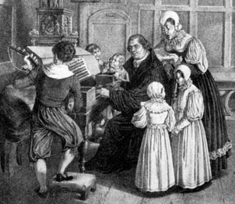
The Altar in the Kitchen
“The Small Catechism, in chart and pamphlet form quickly became one of the most important documents of the Lutheran Reformation. It moved the village altar into the family kitchen, literally bringing instruction in the faith home to the intimacies of family life” – James A. Nestingen, Martin Luther: A Life, 76.

Slide 5
The Catechism and Mission
“Luther’s Small Catechism soon became a standard book for basic Christian instruction in Europe. Its significance for evangelical Lutheran mission to the present day cannot be overestimated” – Ingemar Öberg, Luther and World Mission: A Historical and Systematic Study, 494.

Slide 6
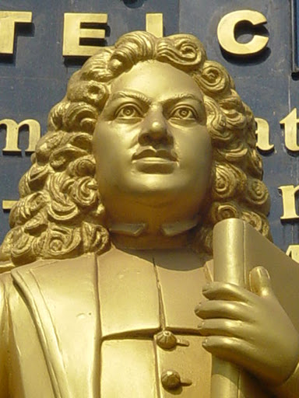
Bartholomew Ziegenbalg (1682-1719)
Ziegenbalg used the Small Catechism for mission work in India beginning in 1707.
Missionaries would continue to translate and use the Small Catechism.

Slide 7
How Did We Get the Small Catechism?
The impact of the Saxon Visitations is seen in Luther’s preface to the Small Catechism: "The deplorable, wretched deprivation that I recently encountered while I was a visitor has constrained and compelled me to prepare this catechism, or Christian instruction, in such a brief, plain, and simple version. Dear God, what misery I beheld! The ordinary person, especially in the villages, knows absolutely nothing about the Christian faith, and unfortunately many pastors are completely unskilled and incompetent teachers. Yet supposedly they all bear the name Christian, are baptized, and receive the holy sacrament, even though they do not know the Lord's Prayer, the Creed, or the Ten Commandments! As a result they live like simple cattle or irrational pigs and, despite the fact that the Gospel has returned, have mastered the fine art of misusing their freedom" (Kolb/Wengert, 347-348)

Slide 8
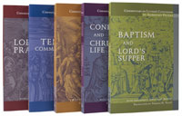
Albrecht Peters has Identified Luther’s Fourfold Purpose for the Catechism

Slide 9
First Purpose: Summary of the Bible
“The catechism as a ‘brief summary and digest of the Bible,’ strives to comprehend its central content. It desires to lay out in simple terms the statements of the biblical witness of God the Father through Jesus Christ, the Son, in the Holy Spirit that are decisive for salvation” (Peters I:20).

Slide 10
Key Points
“Bible for the laity”
Structured by the right distinction between the law and the gospel
Christ-centered

Slide 11
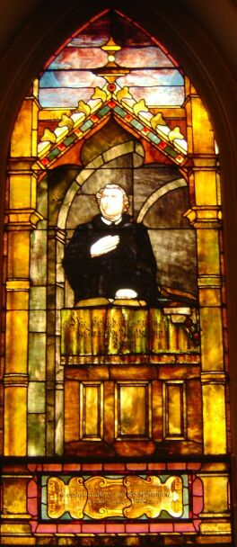
Second Purpose: Catholicity of Texts
“The catechism enunciates the spiritual core of Scripture not as an insight gained by a spiritually gifted individual, but by means of those texts that have prevailed in Christendom and, at the same time, within the history of interpretation of these decisive texts” (Peters I:20).

Slide 12
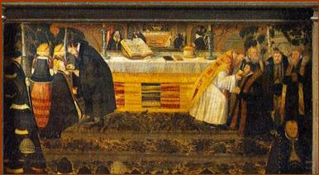
Key Points
Decalogue
Apostles’ Creed
Lord’s Prayer
Baptismal Formula
Instituting Words for Lord’s Supper

Slide 13
Third Purpose: Vocation
“The catechism looks at the concrete daily life of the simple members of the Church. It takes our calling and estate into consideration and understands both as the place in life God gave us in the coordinate system of natural/creaturely, societal/social as well as historical/cultural relations. In our daily life, we Christians should exercise and prove faith in love. The catechism desires to instruct us for this purpose, not only as a doctrinal, confessional book but also as a book of prayer and comfort” (Peters I:20).

Slide 14
Key Points
“How the head of the family should teach his household”
Our location in creation in the First Article as recipients of daily bread (Fourth Petition). Masks of God.
Ten Commandments and the confession of sins.
Table of Duties

Slide 15
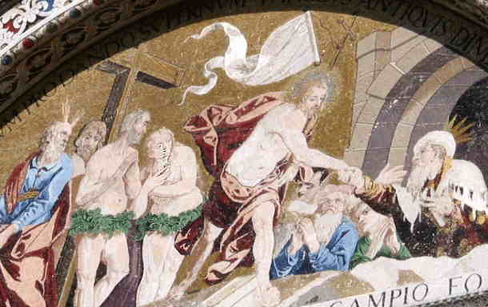
Fourth Purpose: Eschatological
“The catechism moves Scripture, the confession of the Church, and our daily life into the Light of the Last Day” (Peters I:20)

Slide 16
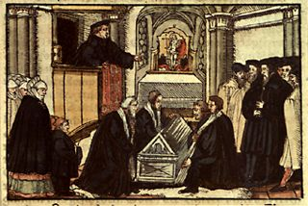
Key Points
The first of Luther’s “Invocavit Sermons”…the summons of death comes to us all…Therefore everyone for himself must know and be armed with the chief things that concern a Christian.

Slide 17
How Luther Intended the Catechism to be Used
Note the pattern for catechesis outlined in the Preface to the Small Catechism: (a) Avoid changes or variations in the text; (b) After people have learned the text, teach them to understand it; (c) Once people have been taught the shorter catechism, take up the longer catechism (SC-Preface 7-18, Kolb/Wengert, The Book of Concord, 348-349). N.B. Peters on “Origin and Structure of the Prefaces” (Peters, 21-26).

Slide 18
Catechization as Pastoral Care
“The catechisms of Luther emerged from a series of sermons, and this might serve as a reminder that they are actually proclamation and catechization. They are, therefore, not to be put back on the shelf like a common book. In the preface to the Small Catechism we find two observations that are foundational for pastoral care. On the one hand, Luther states that every member of the congregation – not only the children- needs to know this basic knowledge of the Christian faith, that is, needs to memorize it. Having memorized the text, then they can begin to interpret and apply it to their life. Luther’s thrust is that the language of the faith must be learned first and must be memorized. To use more than one form will confuse things….” (“R. Slenczka, “Luther’s Care of Souls for Our Times,” 42).

Slide 19
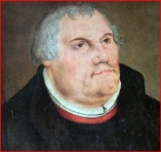
Luther on Praying the Catechism
"I am also a doctor and a preacher, just as learned and experienced as all of them who are so high and mighty. Nevertheless, each morning and whenever else I have time, I do as a child who is being taught the catechism and I read and recite word for word the Lord's Prayer, the Ten Commandments, the Creed, the Psalms etc. I must still read and study the catechism --and I also do so gladly" (Preface to the Large Catechism, Kolb/Wengert, 380).

Slide 20
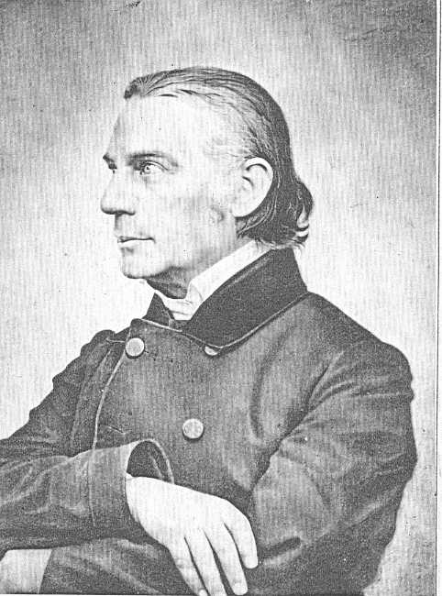
Wilhelm Loehe
“Luther’s Small Catechism is a
confession of the church, the confession
which is most acceptable and familiar
to the people. No one can deny that
no catechism in the world but this one
can be prayed” – Three Books on the
Church, pp. 170-171.

Slide 21
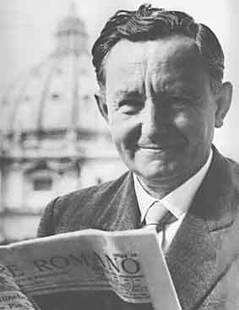
Edmund Schlink
Edmund Schlink (1903-1984) once
characterized 19th century liberalism as
that period of “evangelical theology
during which dogmatics had become
largely a playground for the subjective
originality of speculative piety, in which
Christians generally forgot how to pray
through their Catechism” – Theology of the
Lutheran Confessions, 36

Slide 22
From the Reformation to our Time
In period immediately after the Reformation, numerous Lutheran pastors and teachers produced expanded versions of the Small Catechism to give more complete instruction in Christian doctrine.
A prominent example would be the catechism prepared by Conrad Dietrich (1575-1639)
Dietrich’s catechism was brought to this country by the Saxon’s was essential for the early Missouri Synod.

Slide 23
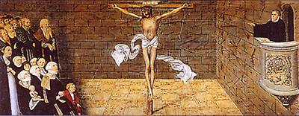
Major Catechism Explanations in the Missouri Synod
Dietrich (1858)
Schwann (1896)
Synodical Catechism (1943 & 1991)
Revised Synodical Catechism (2017)

Slide 24
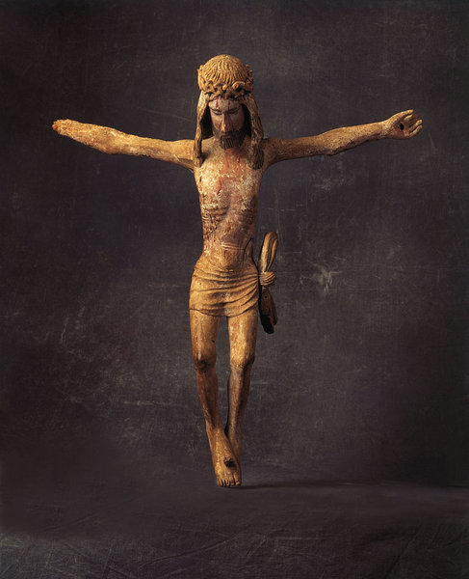
Preview of 2017 Catechism: Template
Central Thought
A Closer Reading of the Small Catechism
Connections and Applications
Hymn and Prayer

Slide 25
Concluding Thoughts
“A Christian is an eternal pupil, from infancy onwards” – Martin Luther (WA 32, 136, 3f)
“From the beginning to the end of the world, God teaches the catechism, and His saints delight in remaining His pupils in this. How can we think that we have already mastered the catechism?” – Albrecht Peters, Commentary on Luther’s Catechisms: Ten Commandments, 26
“Studying and praying the catechism takes place on the battlefield between God and anti-god; there is no neutrality here”- Albrecht Peters, Commentary on Luther’s Catechisms: Ten Commandments, 31

