Slide 1
The Catechism: A FIELD MANUAL FOR DISCIPLESHIP
Reformation Lectures
Concordia Theological Seminary
Fort Wayne, Indiana

Slide 2
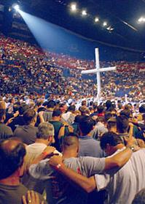
Discipleship: Two Approaches
American Evangelicalism: Fixing the Church
Mainline Protestants: Fixing the World

Slide 3
The Lutheran Take on Discipleship
Discipleship as repentance and faith, death to the old Adam and the resurrection of a new man who lives before God by faith and before the world in love which serves the neighbor.

Slide 4
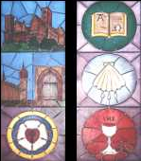
Discipleship is Catechetical
“A catechism is not primarily a book….Rather, catechism is training in a certain body of knowledge” (F. Mildenberger, 140).
Pre-Reformation usage of “catechism”

Slide 5
Luther Recognized the Need
In his Preface to the German Mass (1526), Luther writes that “the German service needs a plain and simple, fair square catechism. Catechism means the instruction in which the heathen who want to be Christians are taught and guided in what they should believe, know, do, and leave undone, according to the Christian faith. This This instruction or catechization I cannot put better or more plainly than has been done from the beginning of Christendom and retained till now, i.e. , in the three parts, the Ten Commandments, the Creed, and the Our Father. These three plainly and briefly contain exactly everything that a Christian needs to know” (AE 53:64-65). Then Luther goes on to suggest how these texts should be taught in the homes in order “to train as Christians” (AE 53:65) children and servants.

Slide 6
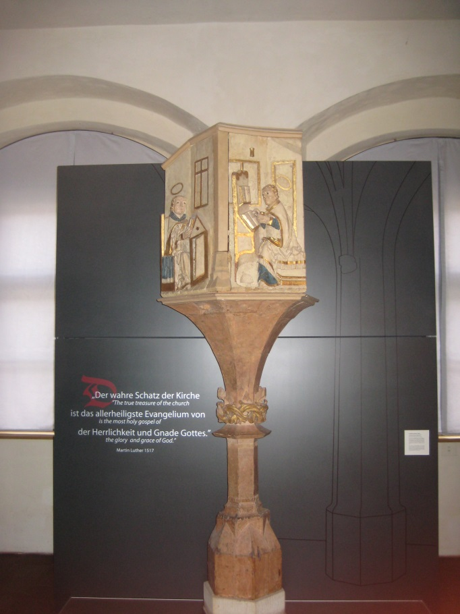
Catechism Sermons: A Few Examples
Lectures on Zechariah (1527)
“Invocavit Sermons” (1522)
Catechetical Sermons (1528)

Slide 7
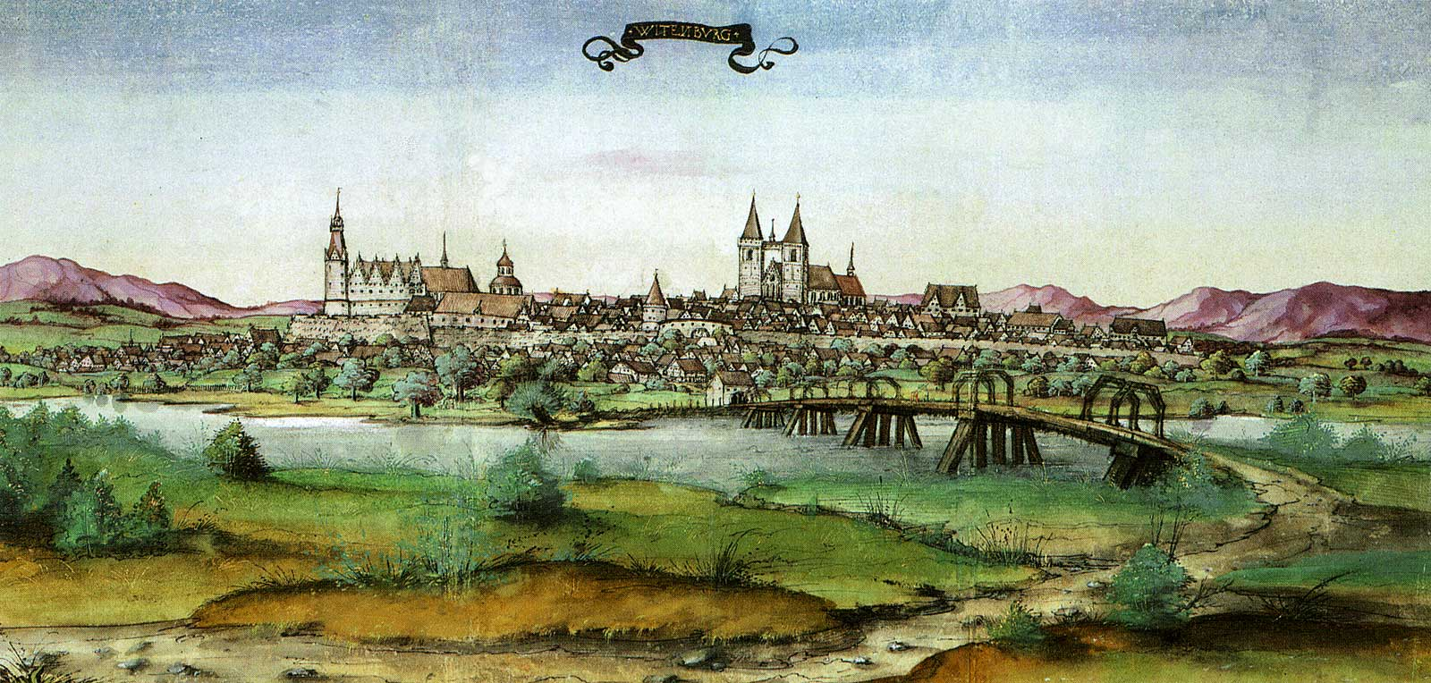
Saxon Visitation (1528)
Deplorable wretchedness!

Slide 8
Pastors are to Teach the Catechism
Luther holds pastors accountable for teaching. In the Preface to the Small Catechism he challenges pastors and preachers, begging them for God’s sake to take up their office, have mercy on their people and “help us bring the catechism to the people, especially the young” (SC Preface 6, K-W, 348).

Slide 9
The Catechism as Multi-dimensional
“Whetstone” (E. Gritsch)
“Compass” (K. Stjerna)
“Theological Swiss Army knife” (C. Arand)

Slide 10
“A Bible of the Laity”
A digest and summary of Holy Scripture

Slide 11
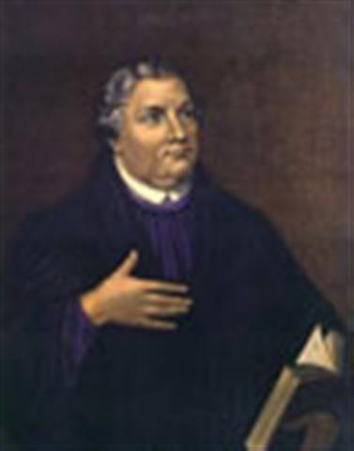
How Luther Structures the Catechism
Medieval Order: Creed, Our Father, Decalogue
Dietrich Kolde (1435-1515): Creed, Decalogue, Our Father
Luther: Decalogue, Creed, Our Father

Slide 12
Catechism: Discipleship & Cross
Where the Word of God is preached and believed there will also be the cross.

Slide 13
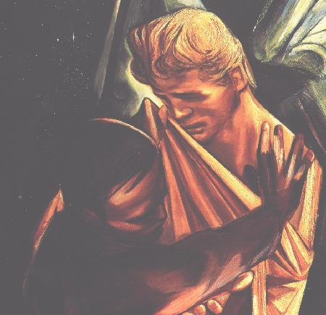
The Catechism as Training for Faith Enduring Attack
Anselm or Luther?
The Christian life under assault by the devil, the world, and the sinful nature

Slide 14
Discipleship According to the Catechism
Oriented by the First Commandment
Confessing the Creed
Calling Jesus’ Father, “Our Father”
Made Disciples in Baptism
Forgiven for the sake of Christ
Strengthened with His body and blood
Life in the world: Daily Prayer and Vocation

Slide 15
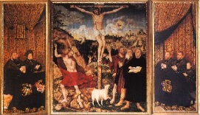
The Use of the Catechism in the Making of Disciples
John Campanius (1601-1683)
Bartholomew Ziegenbalg (1682-1719)

Slide 16
Conclusion

